Slide 1
Morphological Image Processing
Reference:
Digital Image Processing
Rafael C. Gonzalez, Richard E. Woods

Slide 2
Introduction
What is morphology or morphological image processing?
  describes a range of image processing techniques that deal with the shape (or morphology) of features in an image
  Morphological operations are typically applied to remove imperfections introduced during segmentation, and so typically operate on bi-level images
05/08/18

Slide 3


Example
05/08/18

Slide 4
Introduction
Morphological image processing is used to:
  extract image components for representation and description of region shape, such as boundaries, skeletons, and the convex hull.
  edge detection, noise removal, image enhancement and image segmentation.
Morphological techniques probe an image with a small shape or template known as a structuring element.
  The structuring element is positioned at all possible locations in the image.
  It is compared with the corresponding neighborhood of pixels.
  Morphological operations differ in how they carry out this comparison.
05/08/18

Slide 5
Basic Set Theory (1)
If a=(a1,a2) is an element of A: a∈ A
If a is not an element of A : a∉ A
The set with no elements is called the null or empty set and is denoted by the symbol ∅.
If every element of a set A is also an element of another set B, then a is said to be a subset of B: A ⊆ B
The union of two sets A and B is the set of all elements belonging to either A,B or both: C=A∪ B
The intersection of two sets A and B is the set of all elements belonging to both A and B: D=A ∩ B
Two sets A and B are disjoint or mutually exclusive if they have no common elements. A ∩ B = ∅
05/08/18

Slide 6
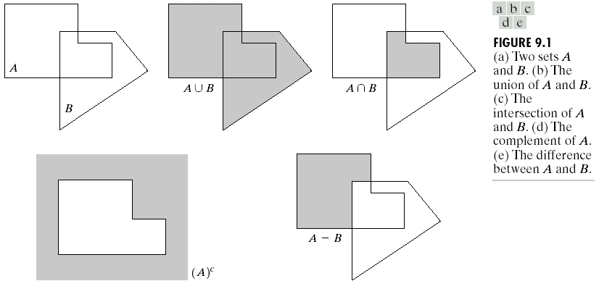
Basic Set Theory (1)
05/08/18

Slide 7
Preliminaries (2)
We define an image as:
  an (amplitude) function of two discrete variables a [m,n] or,
  a set (or collection) of discrete coordinates. The set corresponds to the pixels belonging to objects in the image.
  A
  B
05/08/18

Slide 8
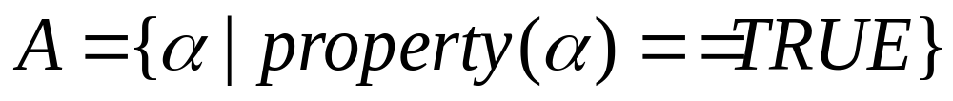
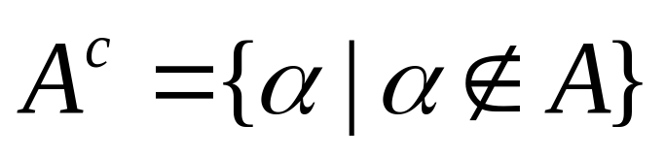
Preliminaries (3)
The object A consists of those pixels α that share some common property:
The background of A is given by A^{c} (the complement of A) which is defined as those elements that are not in A.
Background Object
05/08/18

Slide 9


Preliminaries (4)
The intersection of any two binary images A and B , denoted by A ∩ B, is the binary image which is 1 at all pixels p which are 1 in both A and B:
The union of A and B, denoted by A∪B, is the binary image which is 1 at all pixels p which are 1 in A or 1 in B or 1 in both:
05/08/18

Slide 10
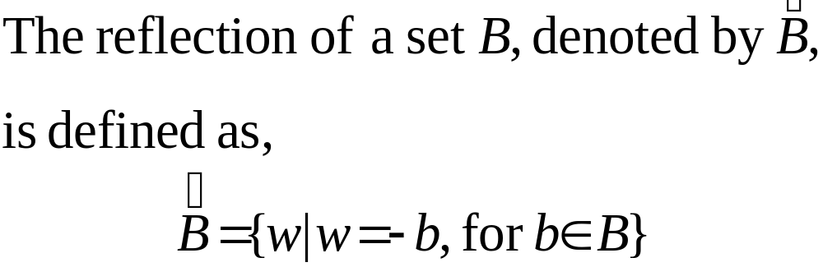
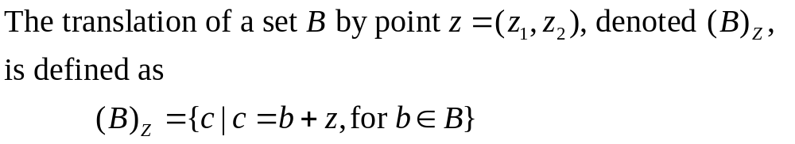
Preliminaries (5)
Reflection
Translation
05/08/18

Slide 11
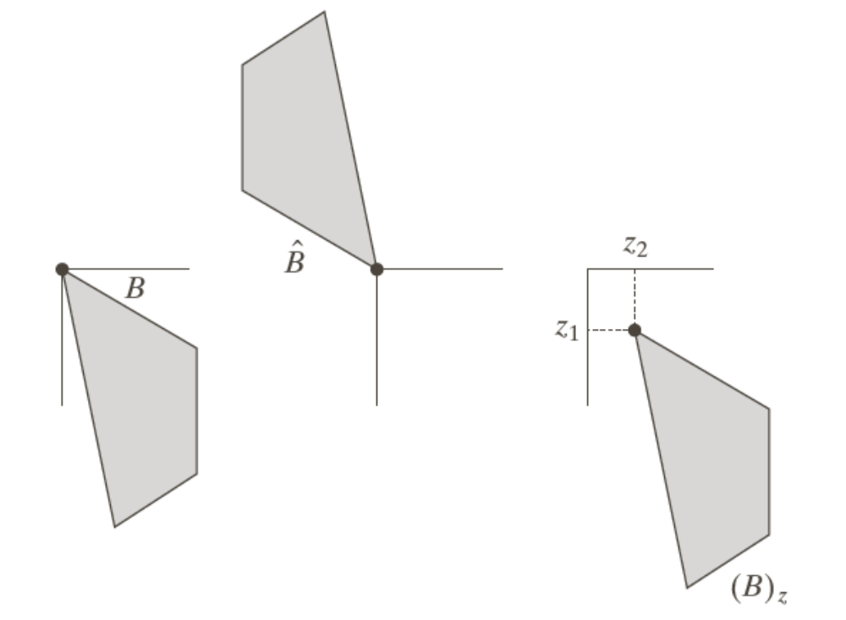
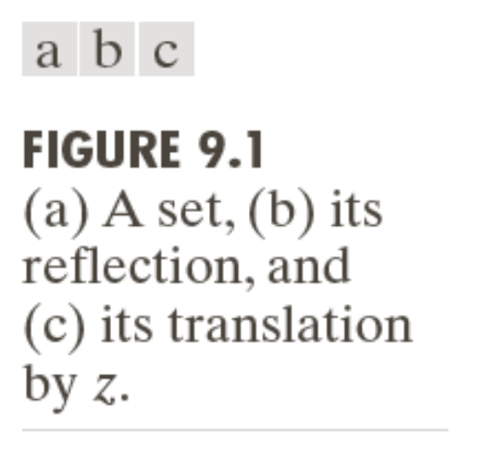
Example: Reflection and Translation
05/08/18

Slide 12
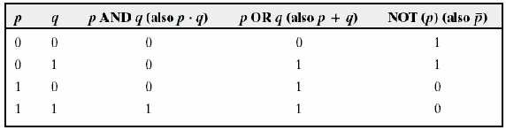
Logic Operations
05/08/18

Slide 13
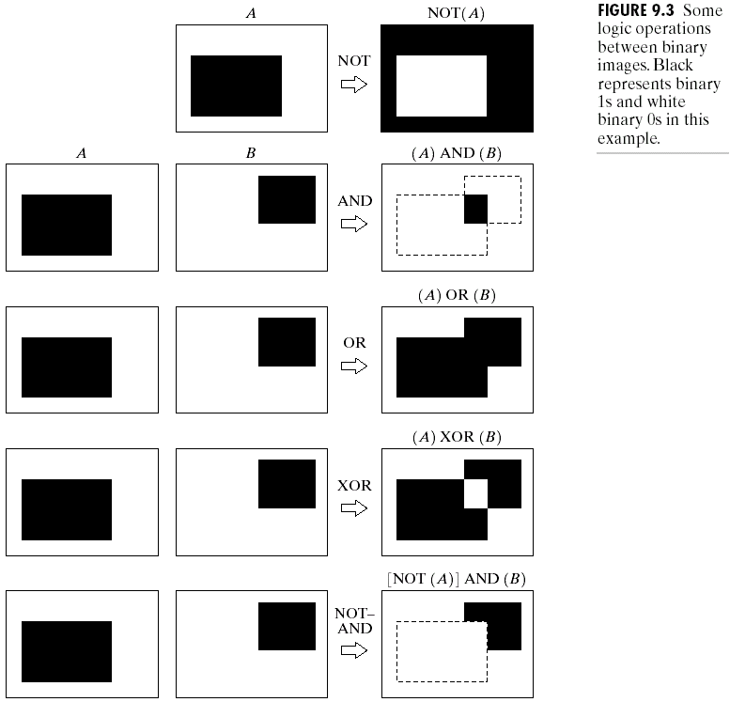
Logic Operations
05/08/18

Slide 14
Preliminaries (6)
Structuring elements (SE)
  Small sets or sub-images used to probe an image under study for properties of interest.
  Consists of a pattern specified as the coordinates of a number of discrete points relative to some origin.
  A convenient way of representing the element is as a small image on a rectangular grid.
  The origin does not have to be in the center of the structuring element, but often it is.
  Structuring elements that fit into a 3×3 grid with its origin at the center are the most commonly seen type.
05/08/18

Slide 15
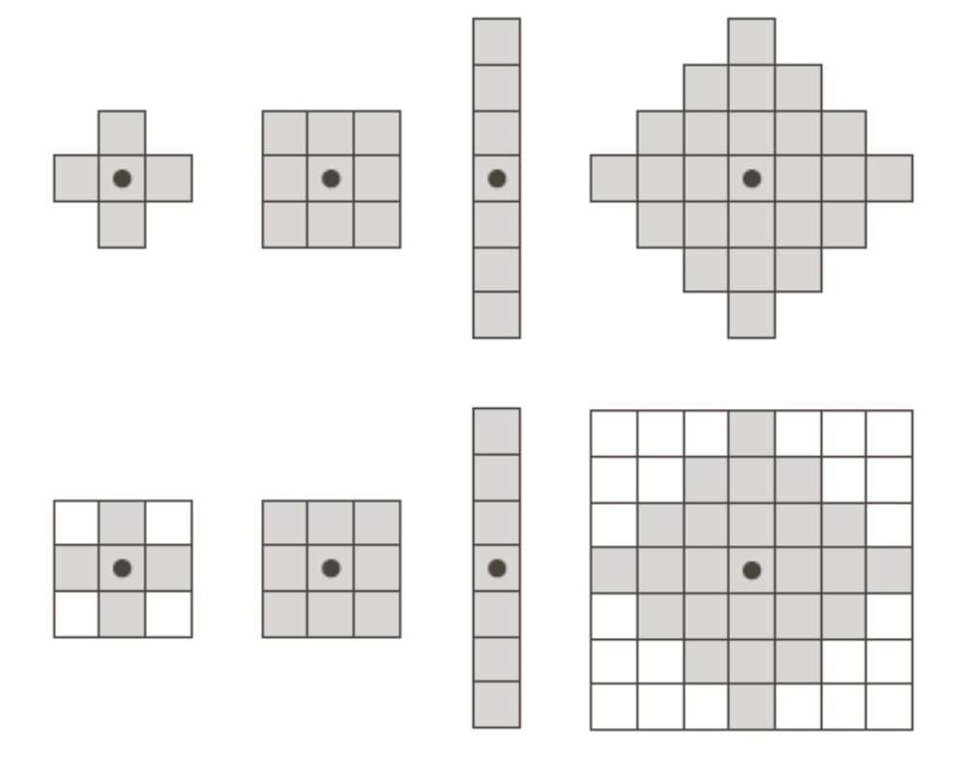
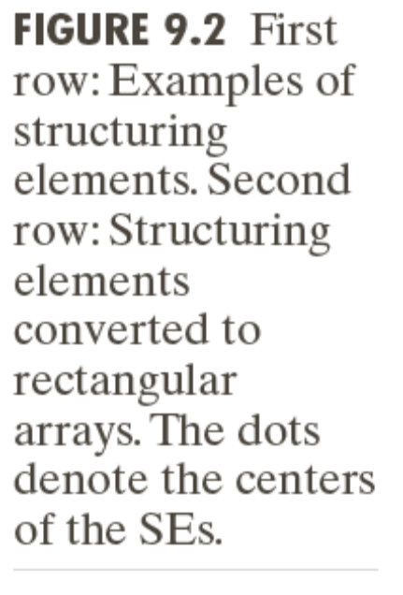
Examples: Structuring Elements (1)
origin
05/08/18

Slide 16
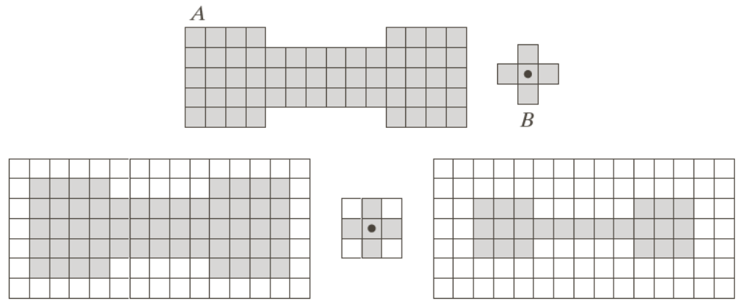
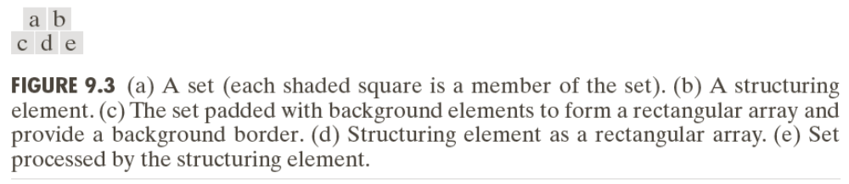

Examples: Structuring Elements (2)
Accommodate the entire structuring elements when its origin is on the border of the original set A
Origin of B visits every element of A
At each location of the origin of B, if B is completely contained in A, then the location is a member of the new set, otherwise it is not a member of the new set.
05/08/18

Slide 17
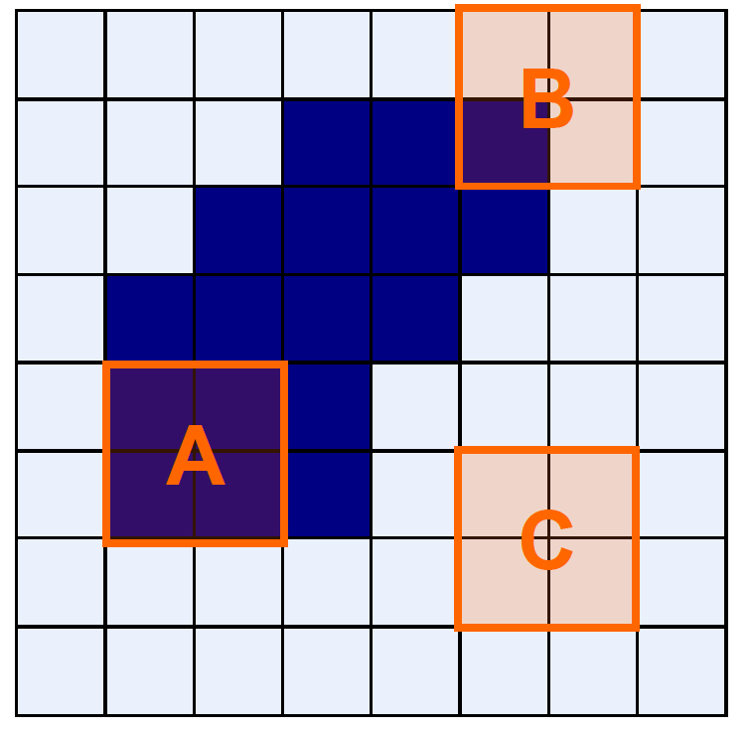
Structuring Elements (Hits and Fits)
Fit: All one pixels in the
structuring element
cover one pixels in the
image
Hit: Any one pixel in the
structuring element
covers any one pixel in the
image
05/08/18

Slide 18


Basic Morphological Operations
Erosion
Dilation
Combine to: Keep general shape but smooth w.r.t.
  Opening Object
  Closing Background
05/08/18

Slide 19
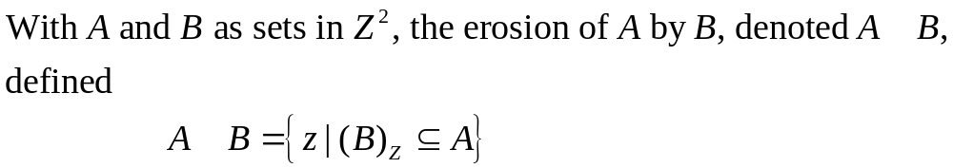

Erosion
Does the structuring element fit the set?
05/08/18

Slide 20
Erosion: How it works
For each foreground pixel, superimpose the structuring element on the input image such that the origin of the structuring element coincides with the input pixel coordinates.
If for every pixel in the structuring element, the corresponding pixel in the image underneath is a foreground pixel, then the input pixel is left as it is.
If any of the corresponding pixels in the image are background, however, the input pixel is also set to background value.
05/08/18

Slide 21
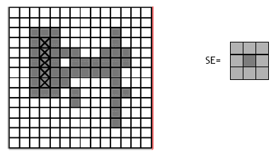
Erosion: How it works
05/08/18

Slide 22
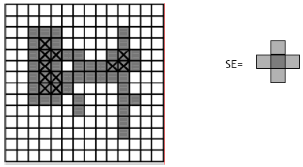
Erosion: How it works
05/08/18

Slide 23
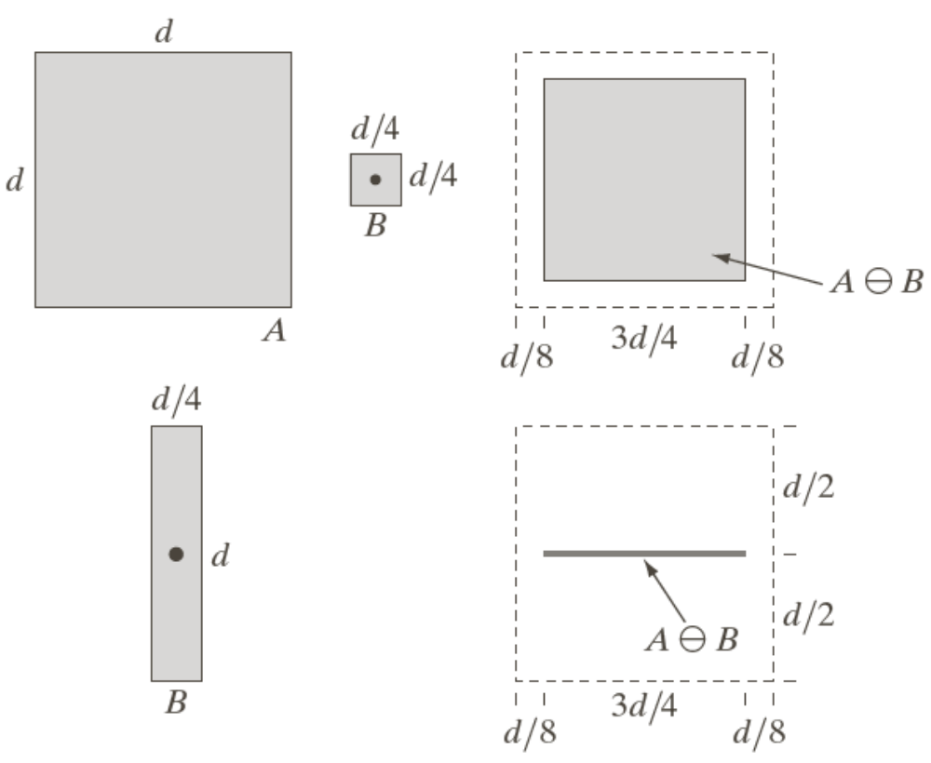

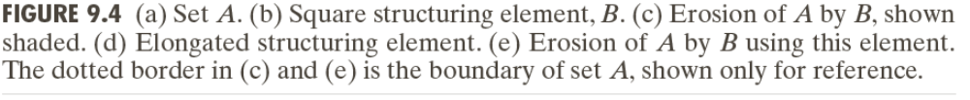
Example of Erosion (1)
05/08/18

Slide 24

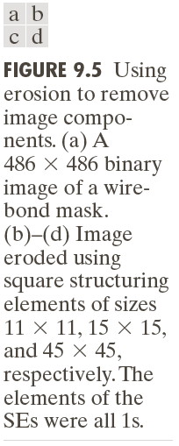
Example of Erosion (2)
05/08/18

Slide 25

Erosion
The basic effect of the operator on a binary image is to erode away the boundaries of regions of foreground pixels (i.e. white pixels, typically).
Thus, areas of foreground pixels shrink in size, and holes within those areas become larger.
05/08/18

Slide 26
Erosion
Erosions can be made directional by using less symmetrical structuring elements.
For example, a structuring element that is 10 pixels wide and 1 pixel high will erode in a horizontal direction only.
Similarly, a 3×3 square structuring element with the origin in the middle of the top row rather than the center, will erode the bottom of a region more severely than the top.
05/08/18

Slide 27

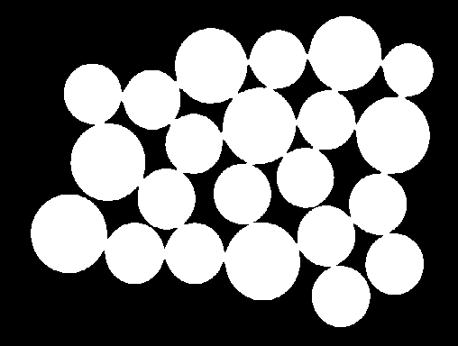
Erosion
There are many specialist uses for erosion.
One of the more common is to separate touching objects in a binary image so that they can be counted using a labeling algorithm.
A no. of dark disks Thresholding at 90
05/08/18

Slide 28

Erosion
Result of eroding twice using a disk shaped structuring element 11 pixels in diameter.
Now the coins can be easily counted.
The relative sizes of the coins can be used to distinguish the various types.
05/08/18

Slide 29

Erosion
9×9 square structuring element is used instead of a disk .
The square structuring element has led to distortion of the shapes, which in some situations could cause problems in identifying the regions after erosion.
05/08/18

Slide 30
Erosion
Erosion can also be used to remove small spurious bright spots (‘salt noise’ ) in images.
We can also use erosion for edge detection by taking the erosion of an image and then subtracting it away from the original image, thus highlighting just those pixels at the edges of objects that were removed by the erosion.
Erosion is also used as the basis for many other mathematical morphology operators.
05/08/18

Slide 31
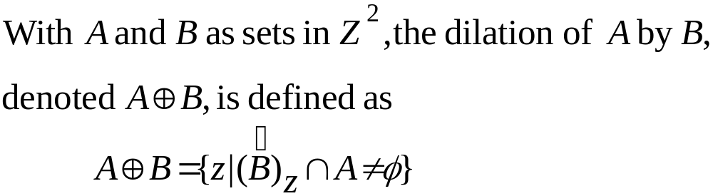
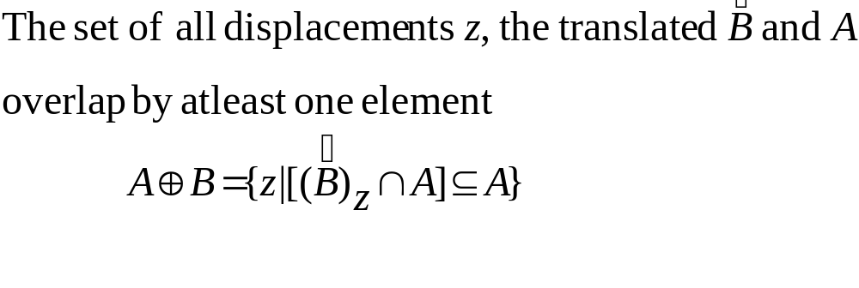
Dilation
Does the structuring element hit the set?
05/08/18

Slide 32
Dilation: How it works
For each background pixel (which we will call the input pixel) we superimpose the structuring element on top of the input image so that the origin of the structuring element coincides with the input pixel position.
If at least one pixel in the structuring element coincides with a foreground pixel in the image underneath, then the input pixel is set to the foreground value.
If all the corresponding pixels in the image are background, however, the input pixel is left at the background value.
05/08/18

Slide 33
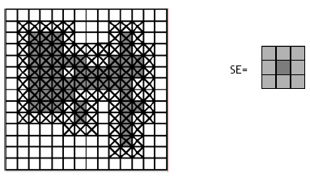
Dilation: How it works
05/08/18

Slide 34
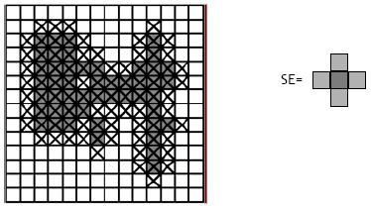
Dilation: How it works
05/08/18

Slide 35
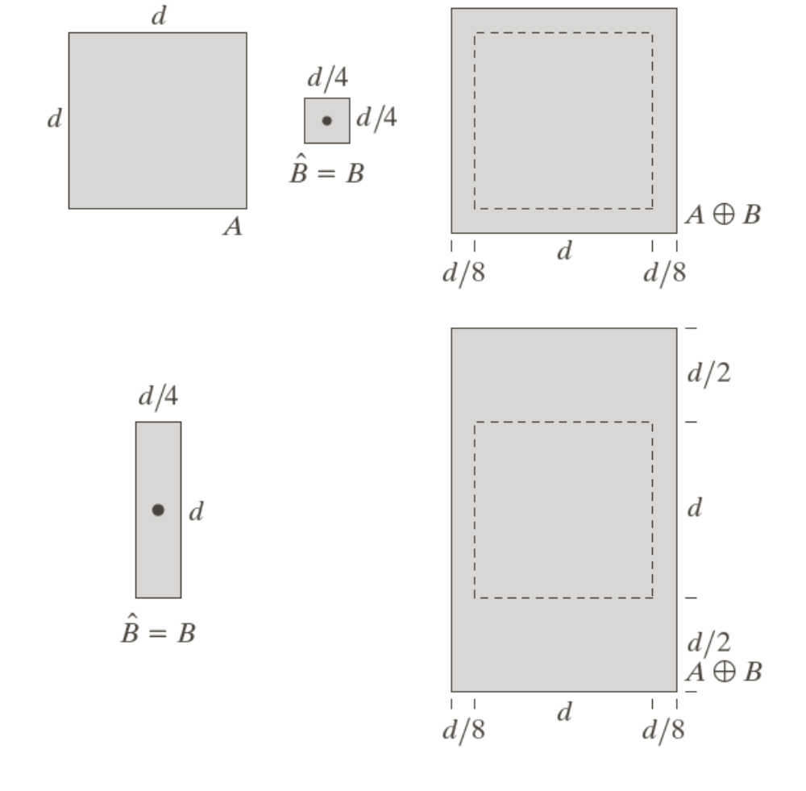
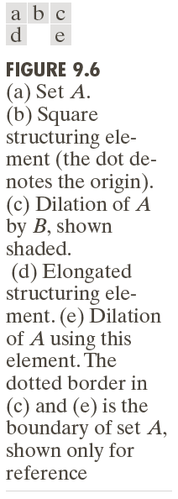
Examples of Dilation (1)
05/08/18

Slide 36
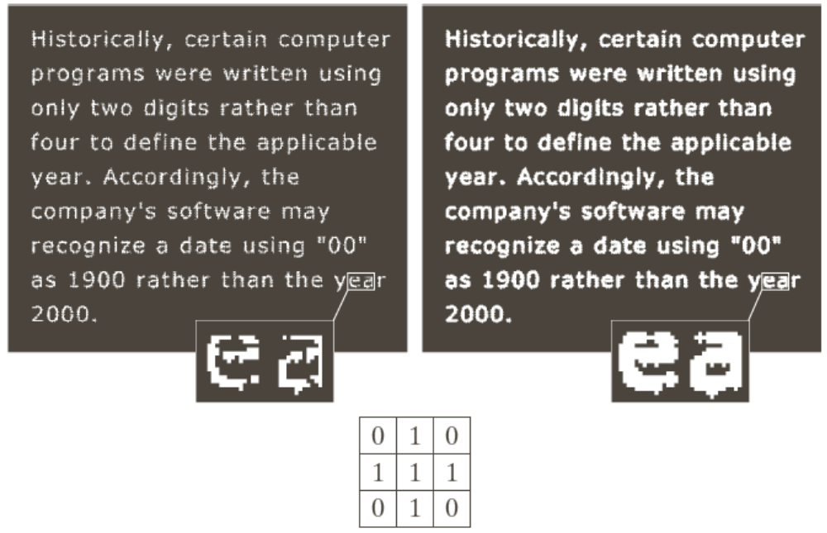
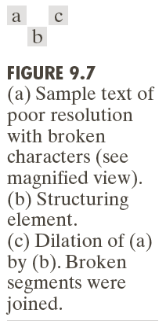
Examples of Dilation (2)
05/08/18

Slide 37

Dilation
The basic effect of the operator on a binary image is to gradually enlarge the boundaries of regions of foreground pixels (i.e. white pixels, typically). Thus areas of foreground pixels grow in size while holes within those regions become smaller.
05/08/18

Slide 38


Dilation
There are many specialist uses for dilation. For instance it can be used to fill in small spurious holes (`pepper noise') in images.
Result of dilating image with a 3×3 square structuring element. Although the noise has been effectively removed, the image has been degraded significantly.
05/08/18

Slide 39

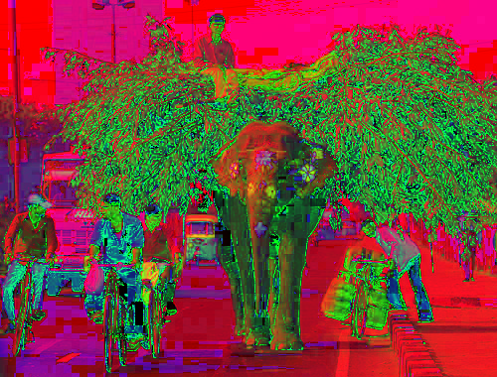
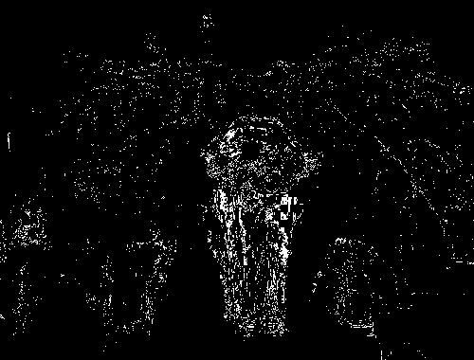



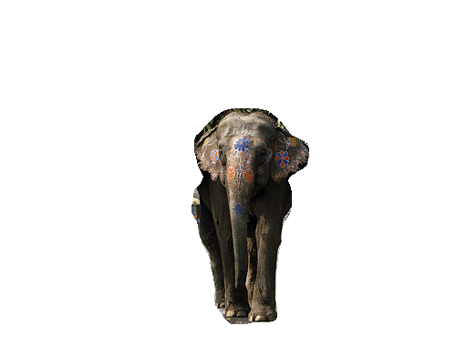
05/08/18

Slide 40
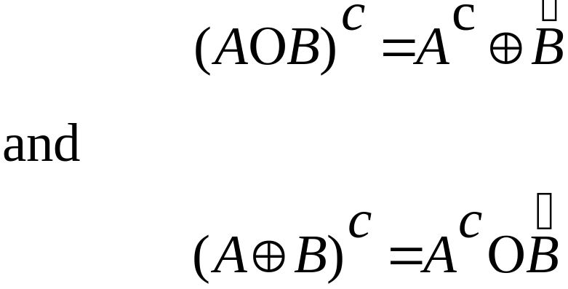
Duality
Erosion and dilation are duals of each other with respect to set complementation and reflection
05/08/18

Slide 41
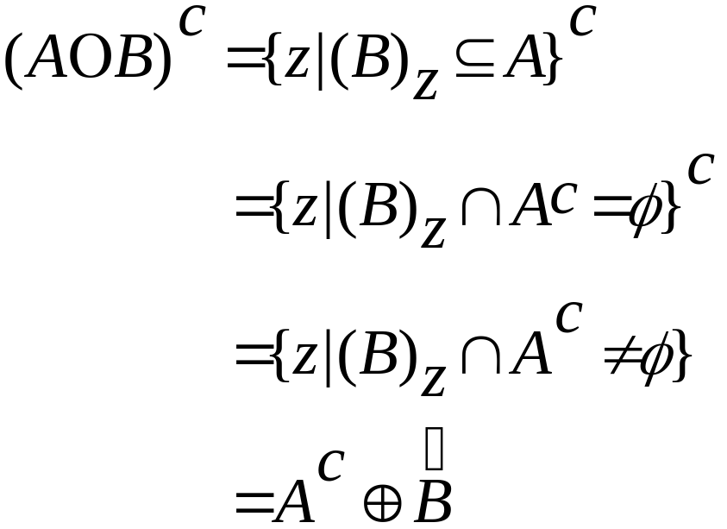
Duality
Erosion and dilation are duals of each other with respect to set complementation and reflection
05/08/18

Slide 42
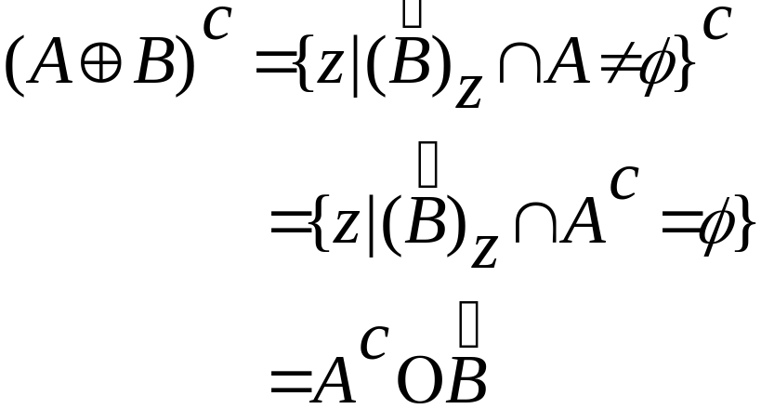
Duality
Erosion and dilation are duals of each other with respect to set complementation and reflection
05/08/18

Slide 43
Opening and Closing
Opening generally smoothes the contour of an object, breaks narrow isthmuses, and eliminates thin protrusions.
Closing tends to smooth sections of contours but it generates fuses narrow breaks and long thin gulfs, eliminates small holes, and fills gaps in the contour.
05/08/18

Slide 44
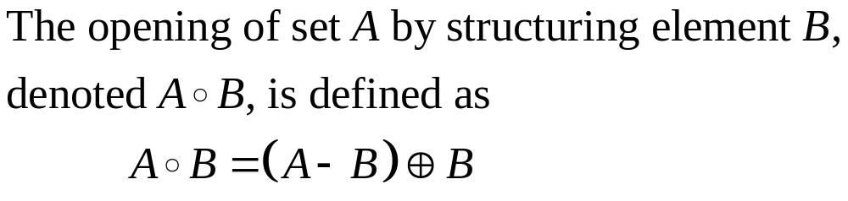
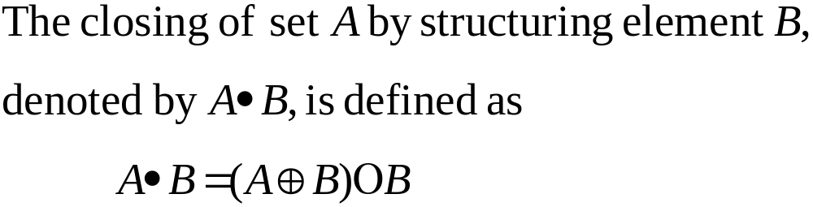
Opening and Closing
05/08/18

Slide 45
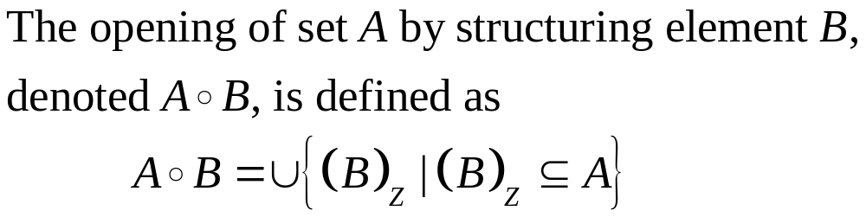
Opening
05/08/18

Slide 46
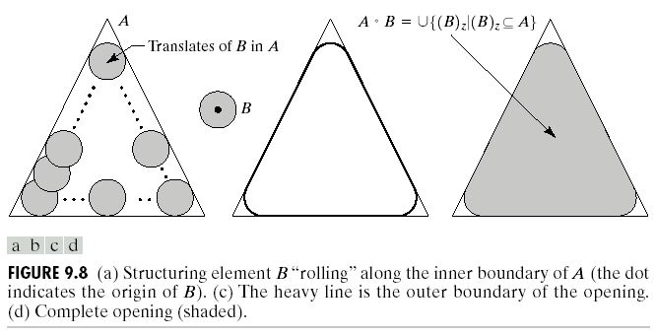
Opening
05/08/18

Slide 47
Opening
The basic effect of an opening is somewhat like erosion.
  It tends to remove some of the foreground (bright) pixels from the edges of regions of foreground pixels. However it is less destructive than erosion in general.
The exact operation is determined by a structuring element.
The effect of the operator is to preserve foreground regions that have a similar shape to this structuring element, or that can completely contain the structuring element, while eliminating all other regions of foreground pixels.
05/08/18

Slide 48
Opening
Erosion has the big disadvantage that it affects all regions of foreground pixels indiscriminately. Opening gets around this by performing both an erosion and a dilation on the image.
Imagine taking the structuring element and sliding it around inside each foreground region, without changing its orientation.
All pixels which can be covered by the structuring element with the structuring element being entirely within the foreground region will be preserved.
All foreground pixels which cannot be reached by the structuring element without parts of it moving out of the foreground region will be eroded away.
The new boundaries of foreground regions will all be such that the structuring element fits inside them, and so further openings with the same element have no effect. The property is known as idempotence.
05/08/18

Slide 49

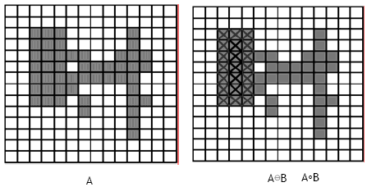
Opening
05/08/18

Slide 50

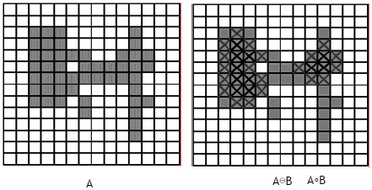
Opening
05/08/18

Slide 51

Opening
As with erosion and dilation, it is very common to use the 3×3 structuring element.
The effect in the figure is rather subtle since the structuring element is quite compact and so it fits into the foreground boundaries quite well even before the opening operation.
To increase the effect, multiple erosions are often performed with this element followed by the same number of dilations. This effectively performs an opening with a larger square structuring element.
05/08/18

Slide 52


Opening
A binary image containing a mixture of circles and lines. Suppose that we want to separate out the circles from the lines, so that they can be counted.
Opening with a disk shaped structuring element 11 pixels in diameter:
Some of the circles are slightly distorted, but in general, the lines have been almost completely removed while the circles remain almost completely unaffected.
05/08/18

Slide 53



Opening
We wish to separately extract the
horizontal and vertical lines.
Opening with a 3×9 vertically Opening with a 9×3 horizontally
oriented structuring element oriented structuring element
05/08/18

Slide 54
Closing
Closing is similar in some ways to dilation:
  it tends to enlarge the boundaries of foreground (bright) regions in an image (and shrink background color holes in such regions).
  but it is less destructive of the original boundary shape.
The effect of the operator is to preserve background regions that have a similar shape to this structuring element, or that can completely contain the structuring element, while eliminating all other regions of background pixels.
05/08/18

Slide 55
Closing
The effect of closing can be quite easily visualized.
  Imagine taking the structuring element and sliding it around outside each foreground region, without changing its orientation.
  For any background boundary point, if the structuring element can be made to touch that point, without any part of the element being inside a foreground region, then that point remains background.
  If this is not possible, then the pixel is set to foreground.
  After the closing has been carried out the background region will be such that the structuring element can be made to cover any point in the background without any part of it also covering a foreground point, and so further closings will have no effect. This property is known as idempotence
05/08/18

Slide 56
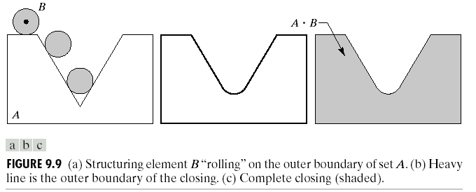
Closing
05/08/18

Slide 57

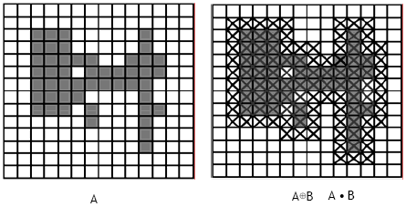
Closing
05/08/18

Slide 58

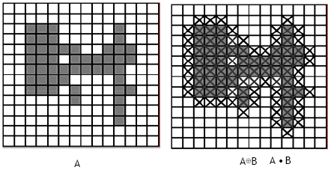
Closing
05/08/18

Slide 59

Closing
Effect of closing using a 3x3 square structuring element.
05/08/18

Slide 60


Closing
An image containing large holes and small holes.
  If it is desired to remove the small holes while retaining the large holes, then we can simply perform a closing with a disk-shaped structuring element with a diameter larger than the smaller holes, but smaller than the large holes.
Closing with 22 pixel dia. disk
05/08/18

Slide 61
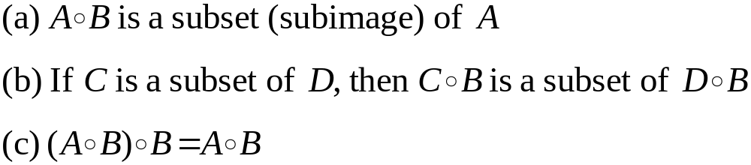

The Properties of Opening and Closing
Properties of Opening
Properties of Closing
05/08/18

Slide 62
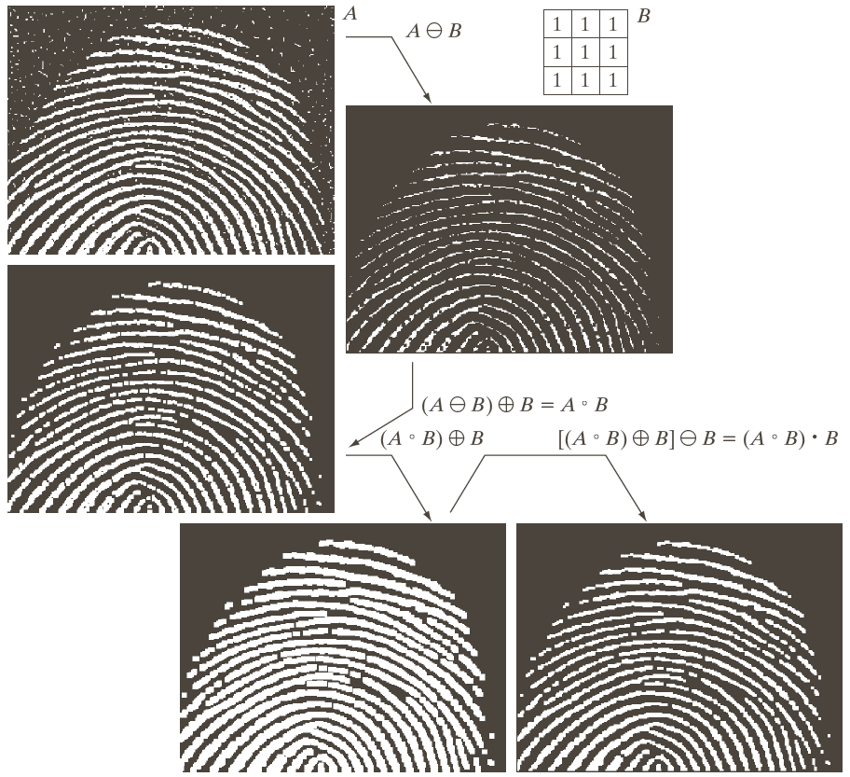
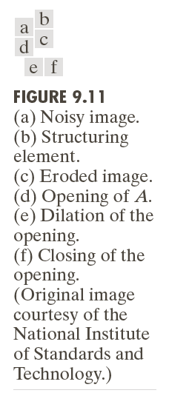
05/08/18

Slide 63
The Hit-or-Miss Transformation
Used to look for particular patterns of foreground and background pixels.
Very simple object recognition.
All other morphological operations can be derived from it.
Input:
  Binary Image
  Structuring Element, containing 0s and 1s.
05/08/18

Slide 64
The Hit-or-Miss Transformation
Similar to Pattern Matching:
If foreground and background pixels in the structuring element exactly match foreground and background pixels in the image, then the pixel underneath the origin of the structuring element is set to the foreground color.
05/08/18

Slide 65
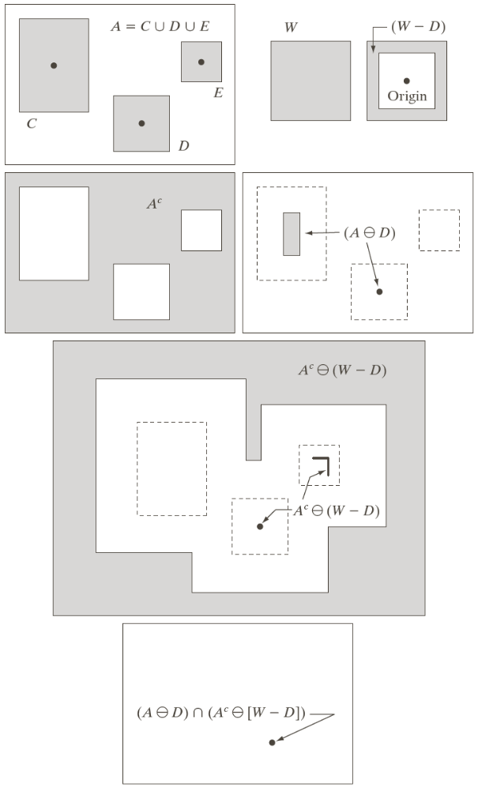
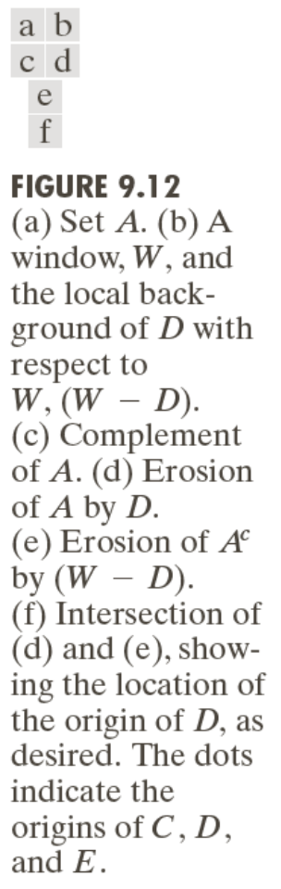
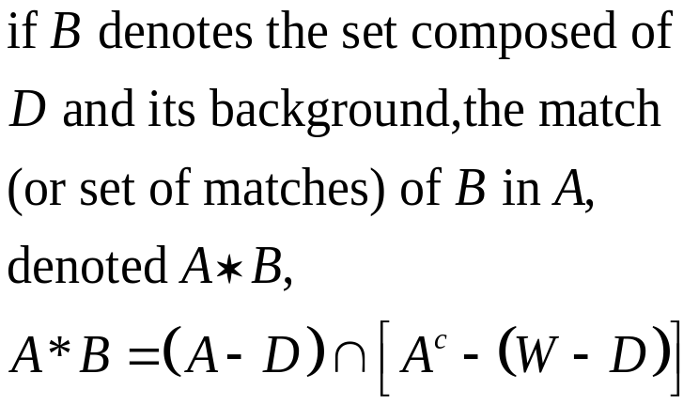

The Hit-or-Miss Transformation
05/08/18

Slide 66

The Hit-or-Miss Transformation
Find location of one shape among a set of shapes: ”template matching”
Composite SE: object part (B1) and background part (B2)
Does B1 fits the object while, simultaneously, B2 misses the object, i.e., fits the background?
05/08/18

Slide 67


The Hit-or-Miss Transformation
Corner detection:
  Structuring Elements representing four corners
  Apply each Structuring Element
  Use OR operation to combine the four results
05/08/18

Slide 68

Some Basic Morphological Algorithms
Boundary Extraction
The boundary of a set A, can be obtained by first eroding A by B and then performing the set difference between A and its erosion.
05/08/18

Slide 69


Boundary Extraction - Example
05/08/18

Slide 70


Boundary Extraction - Example
05/08/18

Slide 71

Some Basic Morphological Algorithms
Region Filling
Region filling applies logical NOT, logical AND and dilation iteratively. The process can be described by the following formula:
where X_{k} is the region which after convergence fills the boundary, J is the structuring element and A_{not} is the negative of the boundary.
05/08/18

Slide 72


Example
05/08/18

Slide 73


Region Filling - Example
05/08/18

Slide 74

Some Basic Morphological Algorithms
Extraction of Connected Components
Let A be a set containing one or more connected components.
Let Y represent a connected component in set A.
Let point p of Y be known. Following yields all elements of Y:
where, X₀=p and B is a suitable structuring element.
05/08/18

Slide 75


05/08/18

Slide 76


05/08/18

Slide 77
Some Basic Morphological Algorithms
Convex Hull
A set A is said to be convex if the straight line segment joining any two points in A lies entirely within A.
The convex hull H or of an arbitrary set S is the smallest convex set containing S.
The set difference H - S is called the convex deficiency of S.
05/08/18

Slide 78

Convex Hull
05/08/18

Slide 79
Convex Hull
The hit-or-miss transformation is applied iteratively to A with B ¹.
  When there is no further change, we perform union with A and call the result D ¹.
Procedure is repeated with B ² and so on.
Union of four resulting D s constitute the convex hull.
  We use simplified hit0or-miss transform in which no background match is done.
05/08/18

Slide 80


05/08/18

Slide 81


Convex Hull
05/08/18

Slide 82

Some Basic Morphological Algorithms
Thinning
The thinning of a set A by a structuring element B, defined by:
Used to remove selected foreground pixels from binary images.
After edge detection, lines are often thicker than one pixel.
Thinning can be used to thin those lines to one pixel width.
05/08/18

Slide 83


Thinning
If foreground and background fit the structuring element exactly, then the pixel at the origin of the SE is set to 0.
Note that the value of the SE at the origin is 1 or don’t care!
  Two Hit-or-Miss transformations
05/08/18

Slide 84


Thinning
A more useful expression for thinning A symmetrically is based on a sequence of structuring elements:
05/08/18

Slide 85


05/08/18

Slide 86



Some Basic Morphological Algorithms
Thickening:
05/08/18

Slide 87



Thickening
Used to grow selected regions of foreground pixels
E.g. applications like approximation of convex hull
If foreground and background match exactly the SE, then set the pixel at its origin to 1!
Note that the value of the SE at the origin is 0 or don’t care!
05/08/18

Slide 88



Some Basic Morphological Algorithms
05/08/18

Slide 89




Some Basic Morphological Algorithms
Skeletons
  To extract a region-based shape feature representing the general form of an object
05/08/18

Slide 90

Skeletonization
Skeletons
  To extract a region-based shape feature representing the general form of an object
05/08/18

Slide 91


Skeletons
05/08/18

Slide 92

Skeletons
05/08/18

Slide 93


05/08/18

Slide 94
05/08/18

Slide 95

Skeletons
05/08/18

Slide 96
05/08/18

Slide 97


Summary (1)
05/08/18

Slide 98


Summary (2)
05/08/18

Slide 99

05/08/18

Slide 100
END
05/08/18

